Slide 1

Reducing Audio Bandwidth with an FFT-based Low-Pass Filter
Andy Henshaw, Trent Geisler, Lauren Staples
MATH 7900 Final Project

Slide 2
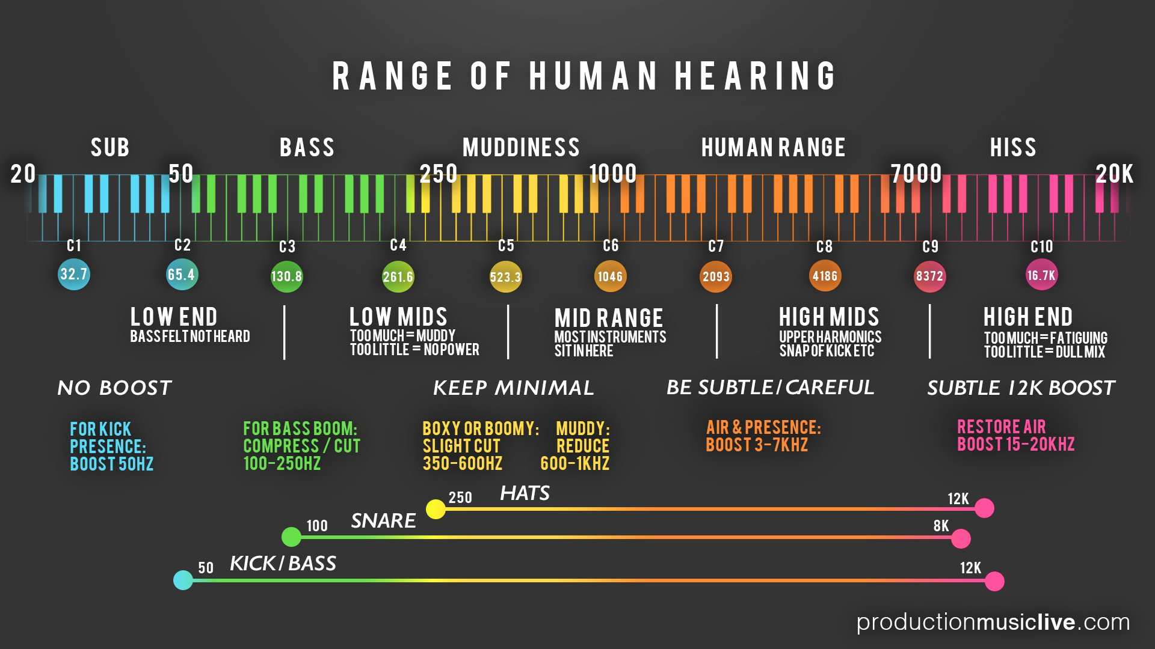
http://onlinetonegenerator.com/hearingtest.html
Notes:
Graphic found at: https://cdn.shopify.com/s/files/1/0993/3800/files/PML_Infographic_-_Audio_Spectrum_2_www.productionmusiclive.com.jpg?_ga=2.91947928.326704852.1575220839-1784720854.1575220839
< C8 is piano. 1st note is 27.5 on the piano. Lowest note is the

Slide 3
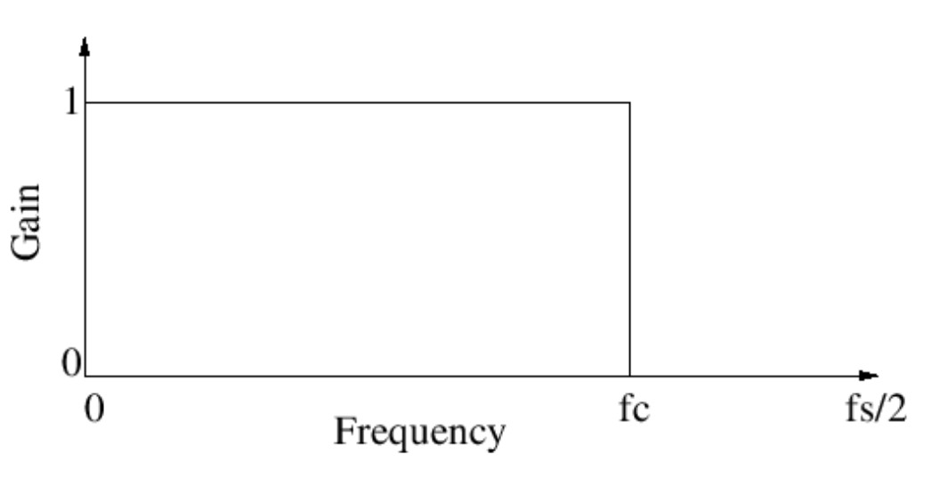
Ideal Low-Pass Filter Design
Notes:
A reduction in bandwidth – when transmitting a shorter “range” bandwidth there are power savings in the transmission. Important because its expensive to transmit long distances and requires a great deal of power.
Gain is a way to amplify something.

Slide 4
Typical Low-Pass Filter Design
Notes:
A sharper transition band -> becomes more computationally expensive (more complex filter in the time domain).
Until recently, it wasn’t practical to use FFT to implement a real-time filter

Slide 5
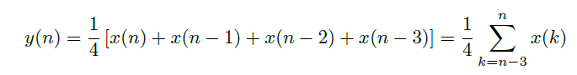
Filter Example: 4-Tap Average
Impulse Response and Filter Coefficients are the same thing!
Notes:
Talk through the diagram…how information flows into the block diagram
- In the time domain, the filter shown in (a) is really a convolution. The other way to do the filter, you can transform into the frequency domain

Slide 6
Output Spectrum: Multiply in Frequency Domain

Slide 7
Filter Design Tool – Frequency Response
Notes:
What the filter design tool will do for us is to give us the Frequency Response of the filter based off of a few desired characteristics.
It’s called ripple (in stopband) and it’s a consequence of the algorithm used to create the filter. There are many different algorithms to do this.

Slide 8
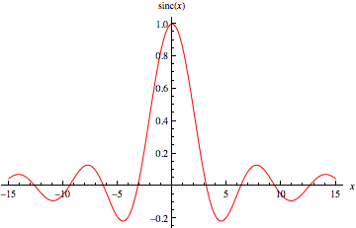
Filter Design Tool – Filter Coefficients
Notes:
Finally, we can easily obtain the filter coefficients from the Frequency Response by taking the Inverse FFT of the Frequency Response information. The FIR filter coefficients are what is used in other tools to implement the filter design.
Put SINC function on side of this.

Slide 9
Magic?
Source: https://imgur.com/gallery/LLUgVSz
Notes:
……….or does the camera speed match the speed of the helicopter? Should we increase or decrease the camera shutter speed to capture the true signal? The helicopter blades are periodic, similar to audio signals.

Slide 10
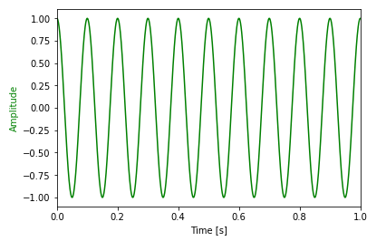
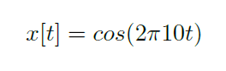
Example Audio Signal
Notes:
If we want to convert an analog signal and process it with a computer, we have to convert to a digital signal. To do that, we must sample. *add a version with a lot of samples. ‘We’ve sampled this at a periodic rate (40 Hz).’ When we sample often enough, we now that there is only one periodic function that would match those points, so that we can reconstruct the original signal. But we have to sample with enough points. But how many points are enough?

Slide 11
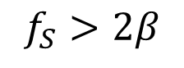
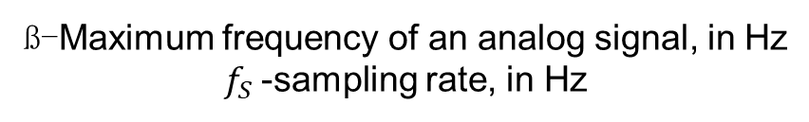
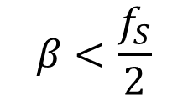
The Nyquist-Shannon Theorem
$$β<\frac{f_{S}}{2}$$
ß-Maximum frequency of an analog signal, in Hz
$f_{S}$-sampling rate, in Hz
$$f_{S}>2β$$
Notes:
The answer is at least twice the rate of the highest frequency component of the analog signal.
What happens when we don’t sample sufficiently?
“if a function x( t ) contains no frequencies higher than B hertz, then it is completely determined by giving its ordinates at a series of points spaced 1 / ( 2 B )
seconds apart. It then follows that a sufficient sampling rate (nyquist rate) is therefore twice the maximum frequency $B$ hertz, $2B$ \cite{shannon:wiki}.

Slide 12
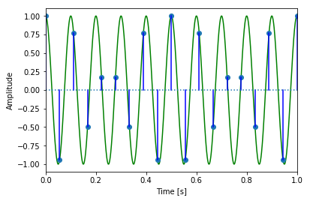
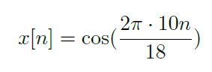
Under-sampled at 18 Hz:
Notes:
N being an index of samples, starting at 0. We arrive here by plugging in n/18 for t.

Slide 13
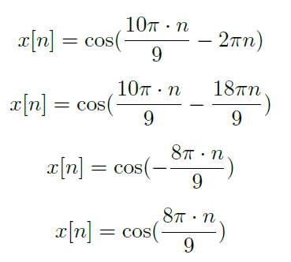
Under-sampled at 18 Hz, continued:
Notes:
*** add the 20 pi over 18
Because the cosine function is periodic, adding or subtracting a full period of 2pi inside the function does not change the function. The alias is caused by whatever is leftover after subtracting a full period. Cosine functions are also even functions, so negative terms become even. 8pi*n/9 is the alias created by our undersampling.

Slide 14
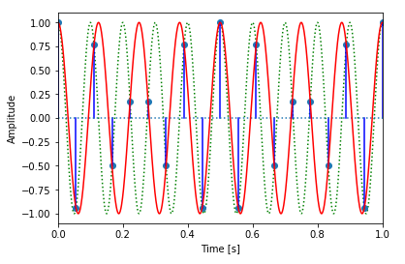
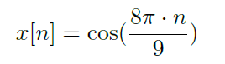
Under-sampled at 18 Hz:
Notes:
There are multiple curves that intersect with our sampling points. The red curve is the curve reconstructed from the alias term caused by our under-sampling.
***x(t) and re-examine the calc with Andy, should be 8 Hz.

Slide 15
Why is the Audio Sample Rate for Compact Discs 44.1 kHz?
Humans hear from 20-20,000 Hz.
From this, we know that the sampling rate should at least be 40 kHz.
Audio signals still have to be passed through an anti-aliasing filter, or low-pass filter.
Even though humans cannot hear beyond 20 kHz, these frequencies can still cause aliasing.
The remaining 4,100 Hz?
A transition band allows greater ease of anti-aliasing filtering.
Notes:
Knowing that we need to sample at atleast twice the rate (of the highest frequency component that we’re interested in), we can see how the decision was made to set the standard sample rate for Compact Discs.
*add animation
The transition band is the area between the passband and the stopband.
So, if we want a filter to pass 0-20Khz without attenuation (reduction), that’s the passband. Typically, we want to reduce signals outside of the passband by 40 dB or more. That’s the stopband. However, if our passband ends at 20 KHz and our stopband starts at 20 KHz, then the transition area is 0. So, our filter needs to be perfectly “sharp”. If our stopband started at 22.05 KHz, then our transition is 2.05 Khz, which is much less sharp.
The complexity of a filter is mainly due to how sharp it is. On the analog side, a sharper filter has more complex hardware and will cost more. On the digital side, a sharper filter means more calculations. Either way, it is of benefit to have a softer filter (less sharp), which means a bigger transition band. A transition band that is about 10% of the passband is common.

Slide 16
Conclusion
A common way of achieving more efficient use of bandwidth is to filter frequencies occurring above the hearing range of humans (20 kHz).
Our project designed several low-pass filters to find the point that optimizes the tradeoff in sound quality and bandwidth on a song called “Flight of the Bumblebee”.
We developed a GNU Radio application that demonstrates FFT-based low pass filter.
Sound-quality deterioration was not discernable until the 4 kHz filter and below.

